Slide 1
Weather Data: It’s Not Like Horseshoes and Hand Grenades
Amy Holm, Gracee Hendrix, Art Yochim, JiSu Bang
Dain Bruns, Cristin Weber, Joe Wuerffel

Slide 2
Apollo and the Need for Environmental Data
Corn tolerance to Apollo was marginal in 2016
Selectivity was seemingly driven by the position of the herbicide in the soil
Speculated that cool, wet soil conditions or the ‘right’ amount of rainfall could cause unacceptable crop injury
Soil moisture and temperature sensors were implemented to address the following objectives:
Use weather date to model injury from Apollo
Investigate outliers in field trials

Slide 3
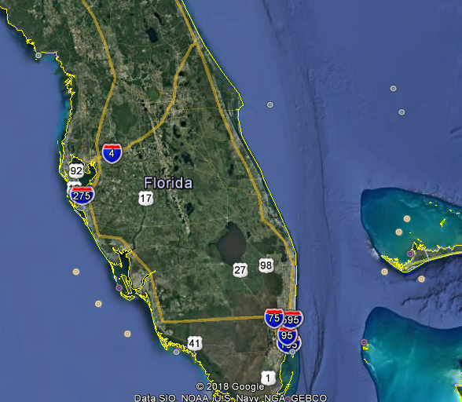
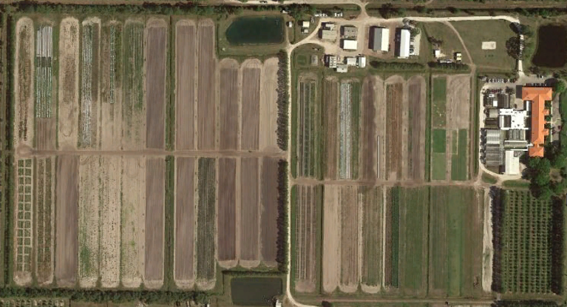
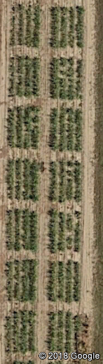
Environmental Variables Important for CP Trialing – Collected over the course of the trial
Types of data:
Rainfall/Irrigation
Temperature
Soil moisture
Soil temperature
Leaf wetness
Relative humidity
???
Data Collection Location and Specificity
Regional level (within 50 – 100 miles)
Site level (at the trial site)
Trial level (within a trial)

Slide 4
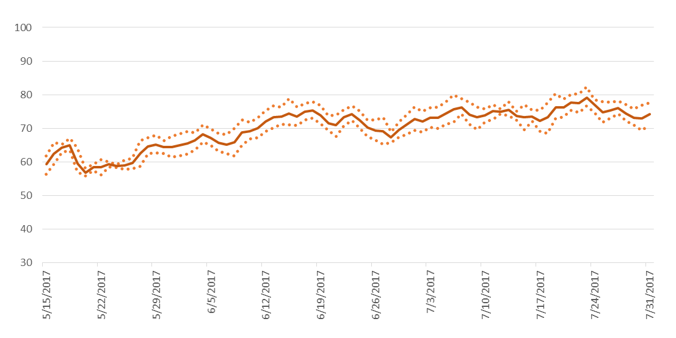
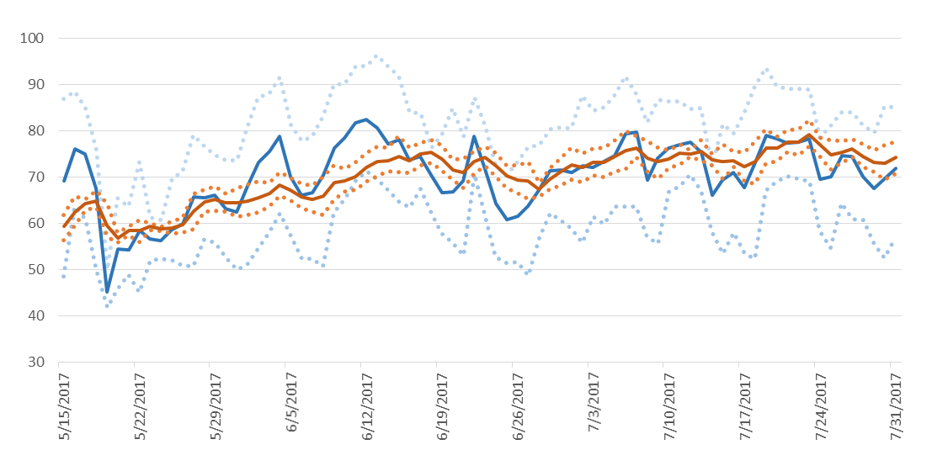
An Example of Comparability of Air Temp vs Soil Temp
Air temperature is not a good proxy for soil temperature!
Daily Soil Tavg
Daily Air Tavg
Daily Soil Tmin/Tmax
Daily Air Tmin/Tmax
Data Source: ND Agricultural Weather Network

Slide 5
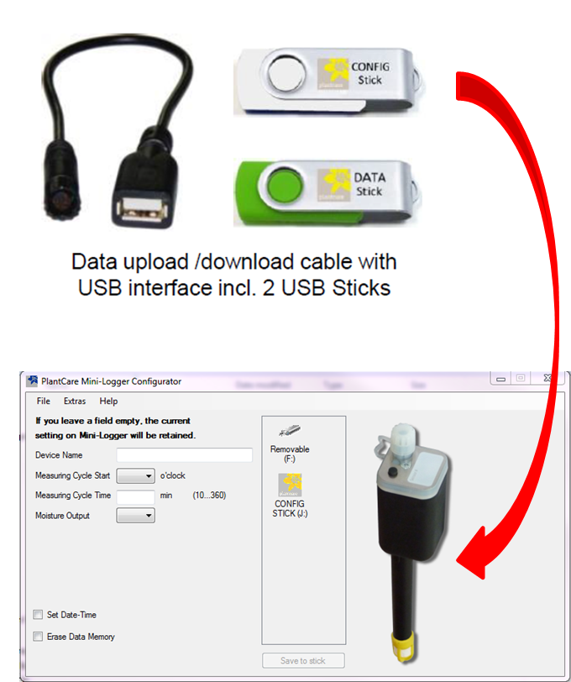
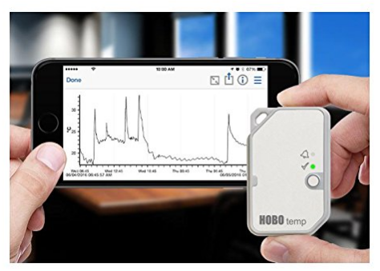
The Problem: Environmental Data Capture Hardware/Software Challenges
Portability: Chasing pests in remote locations… has to “work off the grid”
Usability: Software requires a HelpDesk ticket
Potential solutions:
Portal apps
Bluetooth
???
Power supply: need devices that can be powered in remote locations for months
Potential solutions:
Battery, solar
Notes:
Hobo units – software is an issue… STY firewalls incompatible… we get new computers every few years requiring new software
No way to check soil probe data easily, hobo stations are the same way

Slide 6
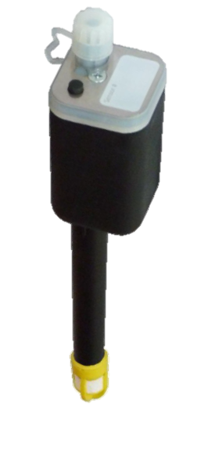
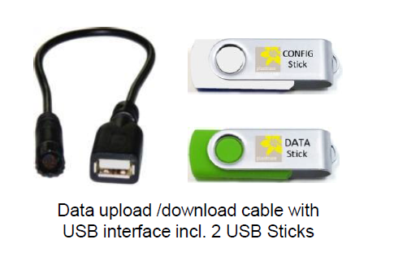
A Solution for Soil Moisture and Temperature
PlantCareTM Soil Probes
Record soil moisture and soil temperature
Durable and simple to launch
Use portal app, no software required
Novel soil moisture recording
micro-thermal measuring: cooling time is measured, which allows a statement about the water content of the soil
Output: relative moisture percentage (%)
Weed Control APOLLO trials: 116 probes, three protocols
Seed Care Pythium trials: ~60 probes, two protocols; excluded from this analysis
Patent for soil moisture probe: http://www.google.sr/patents/US8001990

Slide 7
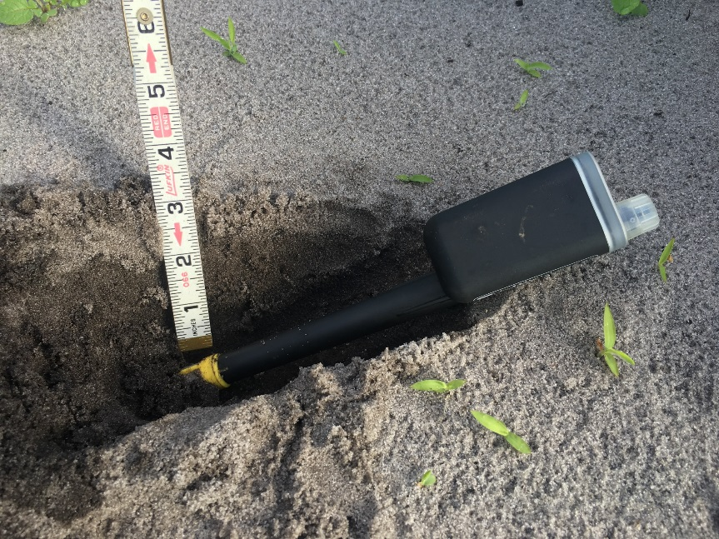
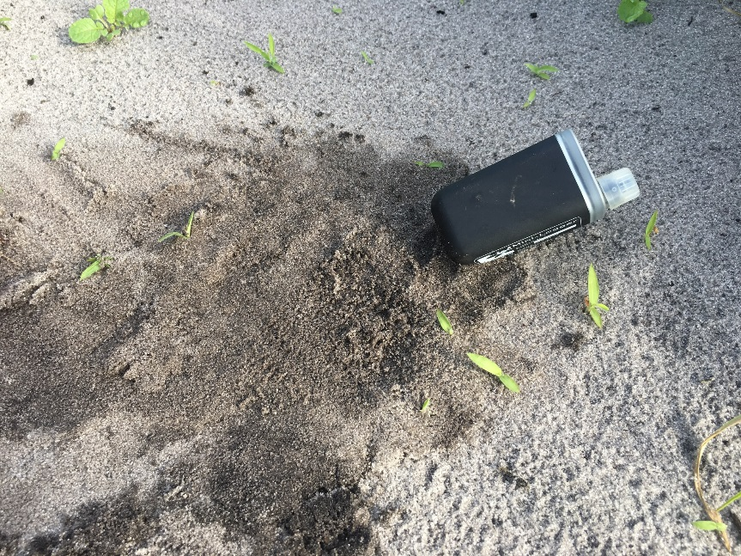
2017 Process for Soil Probes
Loggers were launched and shipped from a central locations
Scientist placed loggers in the appropriate trial and plot at planting
Scientist removed loggers at the appropriate time as per instructions and shipped loggers back to central location.
Data downloaded and compiled at central locations.
*22 minutes per logger for entire process

Slide 8
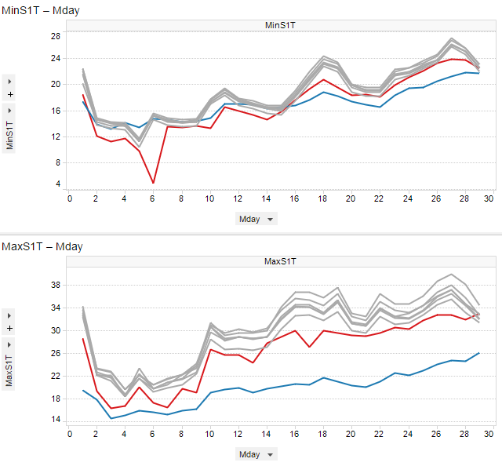
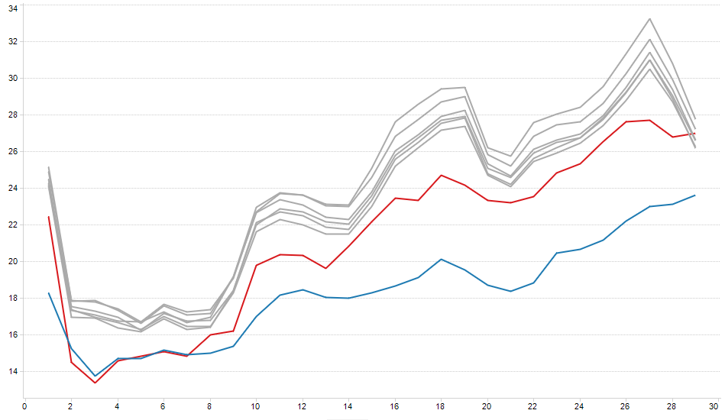

Trials in IL (Silt Clay Loam)
Ref Data ISWS* (bare - 4 in)
Ref Data ISWS* (sod - 4 in)
6 probes (WC096 to WC101) (3 in)
Daily Soil Tavg (C)
Daily Soil Tmin (C)
Daily Soil Tmax (C)
Measurement day
* Reference data from ISWS; 80km southwest

Slide 9
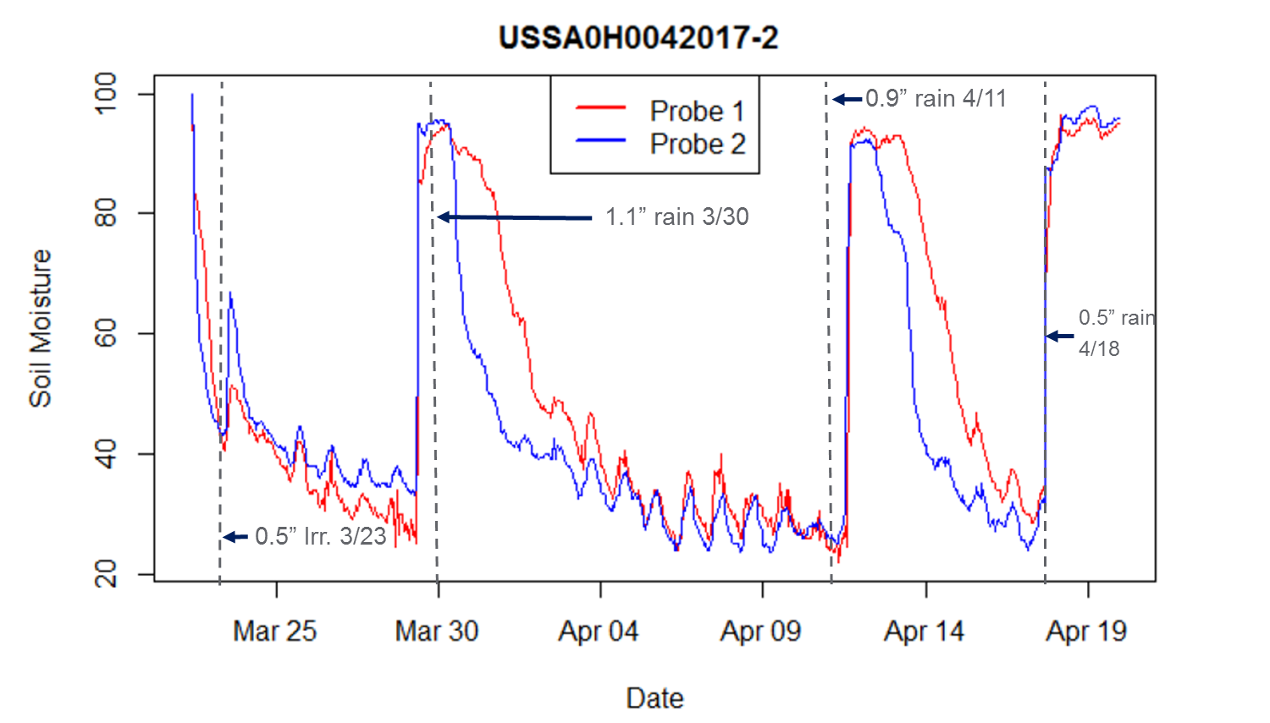
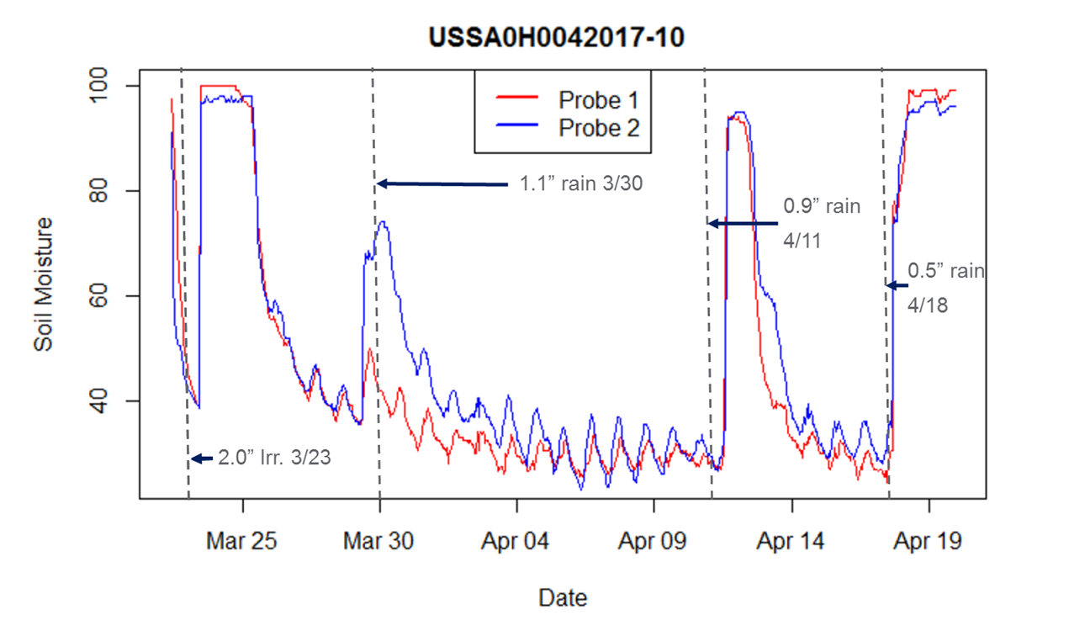
Soil Moisture (Eure) HAP008-2017US
0.5in precipitation
between application and emergence
2in precipitation
between application and emergence
Soil Texture –Clay Loam (34% sand, 44% silt, 22% clay)

Slide 10
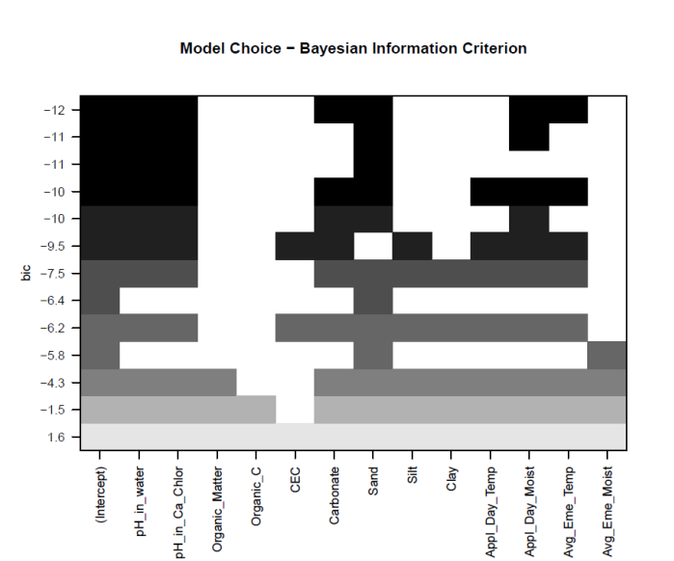

Slide 11
Max PHYGEN - Minnesota
2x
2x
2x
Observed unacceptable injury on fine soil with greater than 4% OM, which was unexpected.
With Apollo
No Apollo

Slide 12
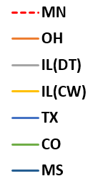
Soil Moisture and Temperature Probe Comparison of Trials Conducted in Fine Soils with Greater than 2% OM
MN
Average daily soil moisture
(% field capacity)
Average daily soil temperature (C)
MN

Slide 13
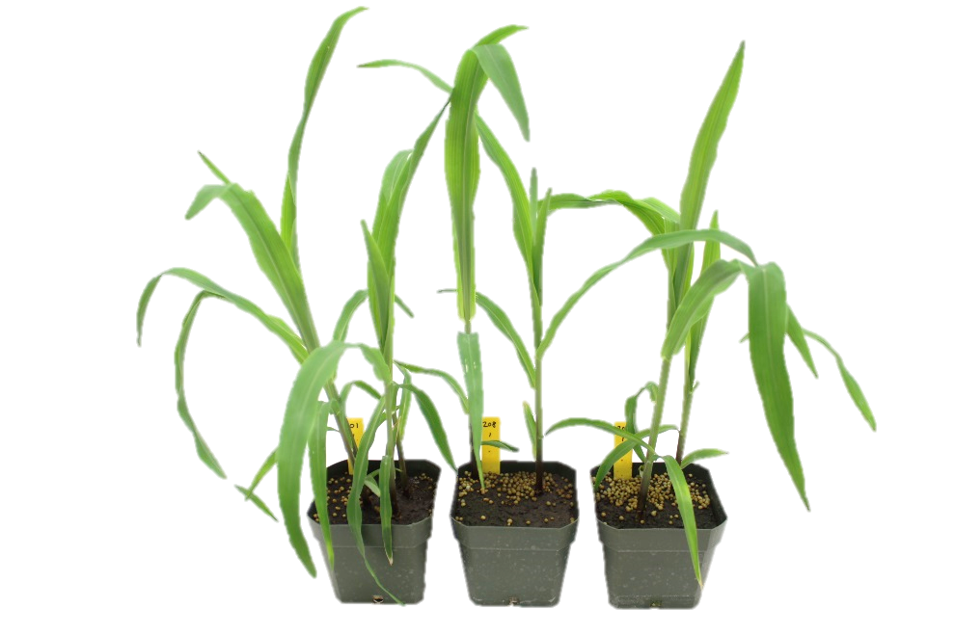
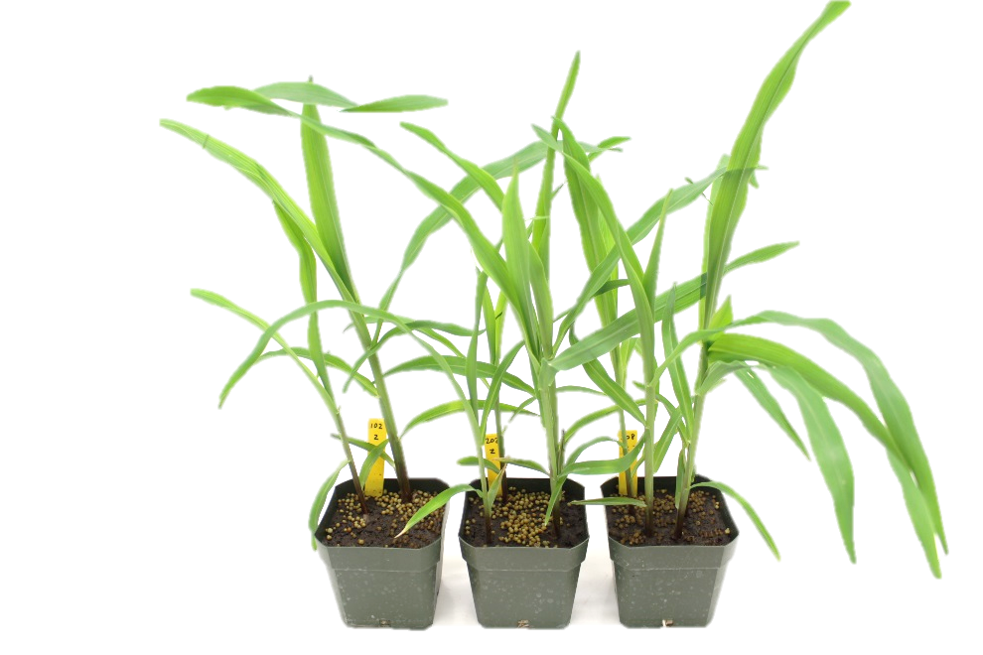
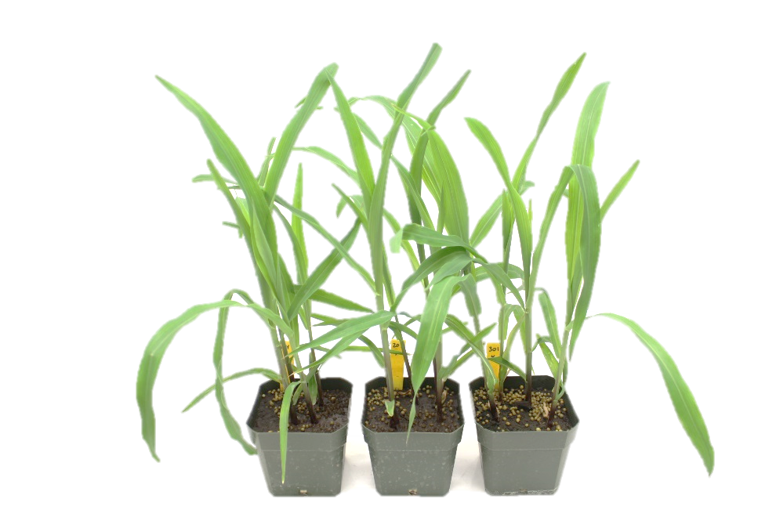
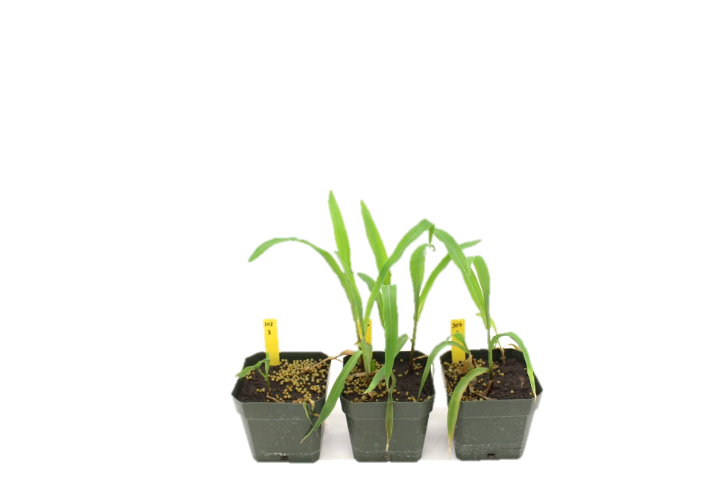
PHYGEN 28DAT
*Corn was in the cold for 14DAE, then moved to the greenhouse until pictures were taken at 28DAE
Untreated
BIR/MST/SMOC
Apollo 600gai
Apollo/BIR/MST/SMOC

Slide 14
Conclusions
Accurate, site level and trial level environmental data can help us make better decisions about our pipeline
Technology is available to more easily capture better site level and trial level data
Where do we go from here?
Questions for discussion:
What types of environmental data need to be collected at the site or trial level?
What types of trials require site level or trial level environmental data?
Are there other challenges with environmental data collection that were not covered?
Are there other technologies that could improve our environmental data collection? (i.e. Bluetooth, low frequencies radio waves)
Do we see value in the soil moisture and temperature probes and how can we improve?
Notes:
Cost per probe $350 Swiss francs per probe
$700 per trial with two probes per trial
Does it need to be centralized?

Slide 15
Environmental Variables Important for CP Trialing – Collected over the course of the trial
Envir. Factor | Collection level
Air temperature
Rainfall/Irrigation
Soil Moisture
Soil Temperature
Leaf Wetness
Relative humidity
???
???
1) Regional level
(50 to 100miles from the trial)
2) Site level
3) Trial level

Slide 16
VBRC Testing In Controlled Greenhouse Conditions – Soil Moisture
Four (4) probes placed in saturated soil
~48hrs for wet probes to recalibrate to dry conditions
Dry probes responded immediately to moisture
Four (4) probes placed in dry soil
48hrs
Probes were switched:
Wet to dry and dry to wet

Slide 17
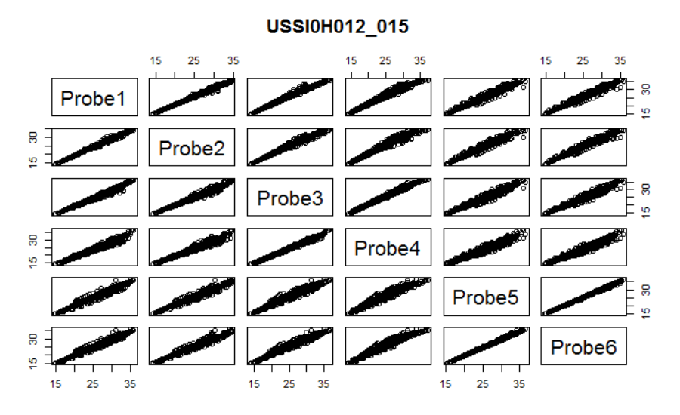
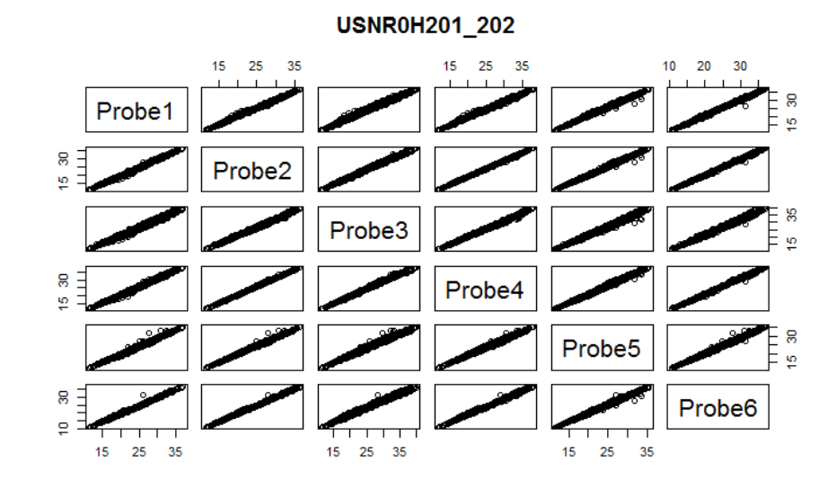
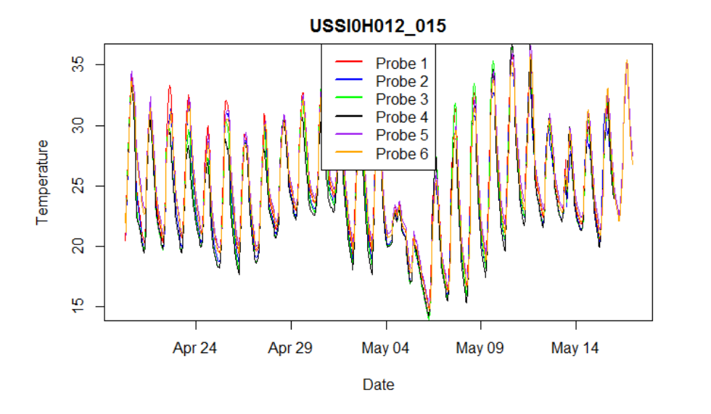
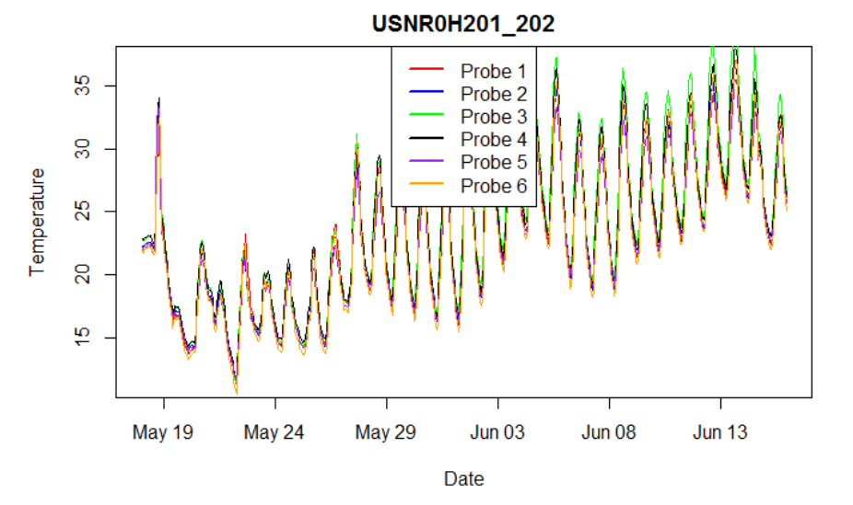
Precision of Soil Temperature Measurements

Slide 18
Correlation of Soil Moisture Readings Within and Among Trials
Correlation Coefficients
Three locations with six probes spread across two trials
Trial 1: Apollo Irrigation trial (HAP008)
Trial 1a: low irrigation for activation
Trial 1b: high irrigation for activation
Trial 2: Apollo mixture protocol (HAP001)
Results
Data within trials were always well correlated (>0.83)
Data among trials was not necessarily well correlated (0.43 to 0.92)
Conclusions
Place probes in each trial that requires soil moisture data
Location 1: USSI
Location 2: USSA
Location 2: USNR

Slide 19
Conclusions
Soil temperature
Soil probes were both ACCURATE and PRECISE
Soil moisture
PRECISION
Trends were very similar between two probes within a trial
Often 20 to 40% variability when placed within a given trial
This variability is not unexpected for soil moisture sensors
Due to probe-to-probe variability or variability in the field???
ACCURACY
Probes responsive to rainfall/irrigation events
Capture minor diurnal moisture fluctuations

Slide 20
Time Commitment
Prep loggers 10min/logger
Replace batteries and tips
Program and launch logger
Ship loggers 2min/logger
Receive, download data, convert data 10min/logger
Total time per logger 22min/logger
Time spent with 116 Apollo loggers in VBRC 43hours

Slide 21
Recommendations
D. Bruns - PlantCare Mini-Loggers are compact, rugged and easy to deploy and retrieve captured soil temperature and moisture data and should be considered for future use in field trials.
Further work is needed to better understand:
Logger to logger variability for % relative soil moisture
Translation of % relative soil moisture (does 100% really mean @ field capacity?)
Include Seed Care trials in the analysis
Keep time commitment in mind for central location (~22min per probe)

Slide 22
Key Questions
Scientists – Should we do anything differently?
TPL/FPCs - Is there value in these probes?
Should we do a more detailed analysis and reconvene before planning meeting?
Will have correlation to Apollo injury data
Can try and gain better understanding of outliers
Need to better understand soil moisture reading through VBRC trials under controlled settings
Will answer question: How many probes per site are necessary?

